Slide 1
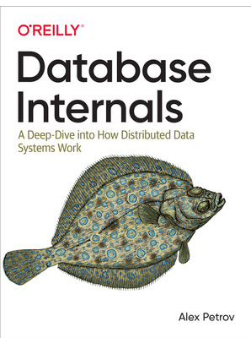
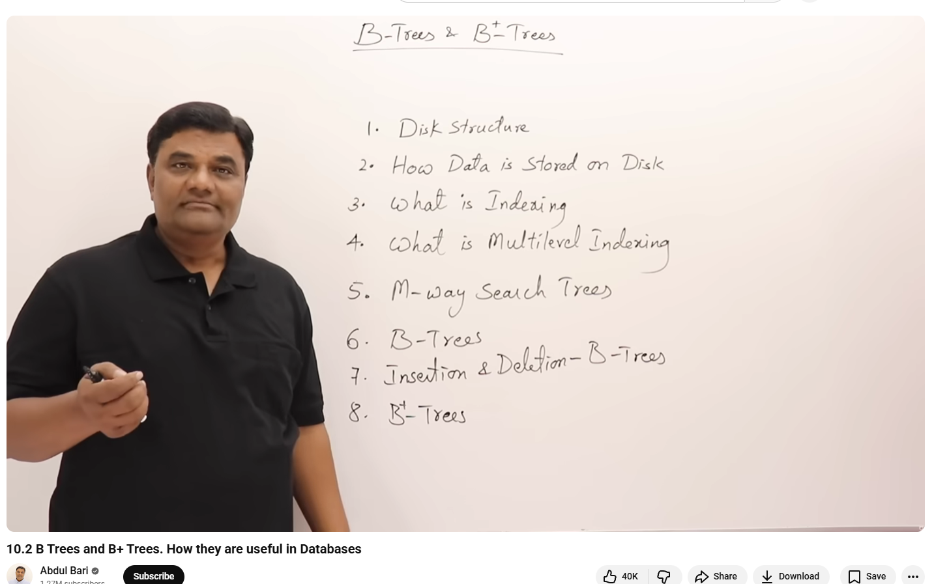
Database Under the Hood
https://www.youtube.com/watch?v=dQw4w9WgXcQ
https://www.youtube.com/watch?v=aZjYr87r1b8

Slide 2
When we run:
SELECT * FROM users WHERE id = 42;
It looks instant.
But internally the database must:
Find where the data lives on disk
Load it into memory
Navigate an index
Return the correct row efficiently

Slide 3
What is the Data structure of a dbms?

Slide 4
Why don’t databases use a sorted array?
[1, 5, 8, 12, 20, 42, 77, 90]

Slide 5
Search:
Binary search → O(log n)
But insert 15:
Shift everything after 12
Rewrite large part of file
Massive disk writes
Problem:
Arrays are bad for frequent insert/delete.
Databases constantly:
Insert rows
Update rows
Delete rows
Arrays are not practical.

Slide 6
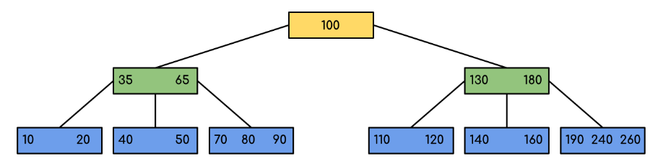
Btrees
Insert is Cheap
When inserting:
Only one path from root to leaf is modified
Occasionally split one node
No massive shifting
Time complexity:
O(log n)

Slide 7
Most relational databases (like PostgreSQL and MySQL) use B-Trees for indexing.
Why B-Trees Work
When inserting into a B-Tree:
Only one path from root → leaf is modified
Occasionally, one node splits
No massive shifting of data
Very few disk writes
Time complexity:
Search → O(log n)
Insert → O(log n)
Delete → O(log n)
Efficient for both reads and writes.

Slide 8
Feature | Sorted Array | B-Tree
Search | O(log n) | O(log n)
Insert | O(n) | O(log n)
Delete | O(n) | O(log n)
Disk Friendly | ❌ | ✅

Slide 9
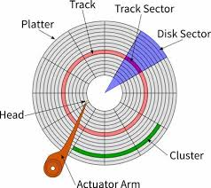
Physical Disk Structure
Traditionally, disks are organized into:
Tracks (Circle)
Sectors (PIZZA)
Blocks (intersecting position)
512 bytes
How Data Is Stored?
Table data is stored in data blocks

Slide 10
Table data is stored in data blocks
Indexes are also stored in blocks
An index does NOT store the full row
It stores:
Pointer to the row location

Slide 11
